Slide 1
Design & Implementation of a Chatbot Study buddy based on RAG
Bianca Bernasconi, Michèle Fust, Alina Lohm, Marion Stutz & Marisa Timm
27th October 2025

Slide 2
Introduction
Introduction
Methodology
Main Results
Outlook
Studying complex topic can often feel like learning a new language. Between lectures, assignments, and dense readings, it‘s easy to lose focus or miss connections.
Study Buddy is an educational chatbot built with Retrieval Augmented Generation (RAG). It answers students‘ questions directly from verified course material and allows them to upload their own study resources (notes, slides, or papers), providing clear explanations and quick refreshers when needed.
The goal: transform confusion into understanding and make learning a little more accessible.
After implementing the RAG chatbot we will focus on evaluating it with suitable KPIS.

Slide 3
Study Buddy Workflow
Introduction
Methodology
Main Results
Outlook
Collect and preprocess study materials (PDF/TXT)
Identify and retrieve most relevant information.
Return context-based response
Contextual accuracy
Feed context to local LLM (Flan-T5)
Maintain an accurate RAG pipeline
Query via Streamlit UI
Embed Query
Extract paragraphs with structure (PyMuPDF)
Create embeddings using SentenceTransformer
Build FAISS index for fast semantic search
Retrieve top-k most relevant text chunks
Combine retrieved chunks with user query
Display source pages + text chunks
Log metrics for latency, similarity, redundancy
Data
Acquisition
Prompt
Augmentation
Output and Maintenance
User Query

Slide 4
Architectural Decisions
Introduction
Methodology
Main Results
Outlook
PyMuPDF for Parsing: Provides layout-aware PDF parsing (accurate extraction of semantically related blocks).
Embedding Model 'all-MiniLM-L6-v2': Balances performance and speed, delivering high-quality sentence embeddings while remaining lightweight for local or server-side use.
Optimizing Chunk Size: Systematically evaluates multiple chunk sizes to identify the one that minimizes semantic overlap, enhancing retrieval relevance and diversity.
FAISS over Alternatives: Low-latency, scalable, and precise indexing—superior to Annoy and ScaNN for academic-scale datasets.
Local LLM (FLAN-T5): Ensures privacy and academic integrity by keeping all data and generation fully on local servers.

Slide 5
Key Performance Indicators
Introduction
Methodology
Main Results
Outlook
To assess overall performance and user experience of the Study Buddy, we defined a structured set of KPIs which will be examined on the following slides.
Category | KPI | Description | Measurement Method
Retrieval Quality | Relevant document in retrieval | Percentage of queries where a relevant document appears in the top-k retrieved results. | Compare retrieved chunks against known relevant ones.
 | Precision | Ratio of relevant documents among the top-k retrieved. | Manual relevance labeling.
 | Average Inter-Chunk Similarity | Measures redundancy between chunks — lower is better. | Compute average cosine similarity between embeddings of top-k chunks.
Robustness | Retrieval robustness | Robustness of retrieval results when queries are paraphrased, partially misspelled, or noisy. | Manual evaluation
 | Faithfulness / Factuality | Extent to which the answer stays grounded in the retrieved context. | Manual rating or LLM-based consistency check.
 | Coherence & Conciseness | Clarity, structure, and focus of generated answer. Are sentences cropped? Is the answer reasonable? | Manual rating.
Technical | Response Latency | Time between user query and first visible answer. Reflects perceived speed. | Measure time difference between user input and first token displayed.
 | Retrieval Latency | Time the retriever takes to return the top-k relevant chunks. Indicates backend efficiency and index performance. | Log start–end time of the retrieval call (e.g., FAISS / Chroma)
User Experience | Perceived Relevance | How relevant users feel retrieved snippets are to their question. | Manual rating after each query.

Slide 6
Retrieval Quality
Introduction
Methodology
Main Results
Outlook
Procedure:
Upload lecture and exercise slides of one semester of one specific lecture.
Define 10 queries and retrieve for each query the Top 5 chunks (k=5).
Goal
Evaluate the quality and relevance of the retrieved information from the course materials.
KPI | Result | Implication
Relevant docs in retrieval | 100% ✅ | High relevance: Relevant documents were consistently retrieved.
Precision | 78% 👍 | Good precision: While precision is fairly high, there’s still room for improvement.
Interchunk similarity | 84% ❌ | Chunk redundancy: More diverse chunks could improve retrieval quality. (e.g. reduce overlap, use different splitting logic e.g. paragraphs or pages instead of number of words)
The model performs well with 100% relevance and 78% precision,
but there's room for improvement in chunk diversity and precision optimization.

Slide 7
Robustness
Introduction
Methodology
Main Results
Outlook
Procedure:
Repeated identical, paraphrased, and typo-altered queries; tested ambiguity and context shifts.
Goal:
Assess RAG answer stability under varying query conditions.
Result
✅ | Stable: 90–95% consistent responses
⚠️ | Slight drop with long or nested queries
❌ | generic replies for unseen or incomplete contexts
RAG shows strong robustness across prompt variations. Core retrieval stays consistent; minor deviations stem from LLM reasoning. Further gains possible via context filtering, spell check, and prompt normalization.

Slide 8
Robustness
Introduction
Methodology
Main Results
Outlook
Overall robustness score: ~88 % consistent answers across variations.
Highest stability for repeated and paraphrased queries.
Minor sensitivity to typos and context shifts.
Indicates strong retrieval consistency; errors mainly stem from LLM interpretation, not from retrieval.

Slide 9
Technical
Introduction
Methodology
Main Results
Outlook
Procedure:
Different prompts were submitted sequentially
Logs were collected and analyzed using Python code
Goal:
Identify where delays occur and whether the system meets usability targets for smooth interaction.
KPI | Result | Implication
Response latency | 👍 | Response latency fluctuates more strongly, with occasional peaks above the 3-second target, especially at the beginning of testing. the average response time is 6.4 s (median 4.5 s), indicating that most queries are answered near the target, though some outliers slow down the mean.
Retrieval latency | ✅ | Retrieval latency remains almost constant and well below the 1-second target. It is consistently fast with an average of only 0.1 s.
The clear gap between retrieval and response latency suggest that the bottleneck lies in the LLM generation, not in the search process.

Slide 10
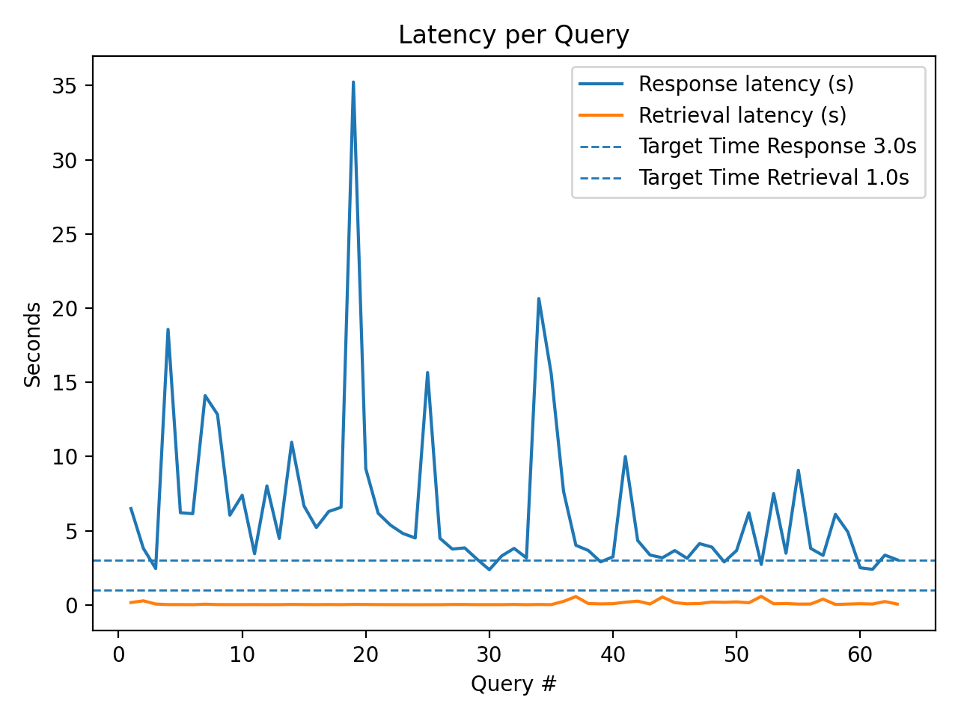
Technical
Introduction
Methodology
Main Results
Outlook
KPI | Mean (s) | Median (s) | Target Time
Response latency (s) | 6.397 | 4.481 | ≤ 3.0s
Retrieval latency (s) | 0.097 | 0.033 | ≤ 1.0s
Reasoning for Target Time:
Response = 3 s: User satisfaction and engagement begin to decline once system response times exceed roughly three seconds. Within this range, interaction still feels responsive enough to maintain conversational flow, while longer pauses interrupt perceived continuity.
Retrieval = 1 s: Studies on search latency show that even small delays measurably reduce user preference, making ~1 second a practical upper bound for smooth query handling.

Slide 11
User Experience
Introduction
Methodology
Main Results
Outlook
Procedure:
A glossary with definitions of terms from one semester across all modules was uploaded.
Five topics/terms were queried.
Goal:
How relevant do users feel retrieved snippets are to their question?
Result
✅ | The sources provide relevant content and actually answer the question.
⚠️ | The answers make more sense if the question starts with 'explain' or 'describe' instead of 'what’.
❌ | The answers are rather brief and sometimes start in the middle of a sentence.
As already mentioned by the retrieval quality test, adjusting the chunks would improve the quality of the answers and snippets.

Slide 12
Optimization Potential
Introduction
Methodology
Main Results
Outlook
Document processing
Documents containing formulas or tables are currently not retrieved effectively; optimization is needed to improve handling of more technical content.
LLM optimization
No LLM temperature leads to copied text passages, so it should be increased slightly to obtain more natural responses.
Technical optimization
Warm-up or caching could reduce initial response spikes
Shorter chunks chould further improve speed.
Reducing high inter-chunk similarity can enhance answer quality and overall efficiency.

Slide 13
Appendix

Slide 14
Disclosure of GenAI
ChatGPT was employed as a digital research assistant throughout the preparation of the implementation of this RAG chatbot and its evaluation. The tool was used to explore coding approaches and suitable analytical evaluation metrics. All generated material was critically reviewed, refined, and verified by us to ensure accuracy, scientific soundness, and coherence with the project’s objectives. ChatGPT did not make independent decisions; it served as a supportive instrument to enhance efficiency, consistency, and clarity in the documentation and implementation of our analysis.

Slide 15
References
Slide 5
PyMuPDF: Tutorial - PyMuPDF documentation
All-MiniLML6-v2: sentence-transformers/all-MiniLM-L6-v2
Hugging Face / Pretrained Models — Sentence Transformers documentation
FIASS: What's the difference between FAISS, Annoy, and ScaNN?
Slide 10
Target Time: https://static.googleusercontent.com/media/research.google.com/de//pubs/archive/34439.pdf?utm_source=chatgpt.com

